Slide 1
Programming Fundamentals
Lecture 22

Slide 2
Objectives
Inheritance
Base Class and Derived Class
Derived Class Constructors
Modes of inheritance
  Public mode
  Private mode
  Protected mode
Creating a class by UML class diagram
Function Overriding

Slide 3
Inheritance
Inheritance in Object Oriented Programming can be described as a process of creating new classes from existing classes
Inheritance allows us to define a class in terms of another class, which makes it easier to create and maintain an application
This also provides an opportunity to reuse the code functionality and fast implementation time

Slide 4
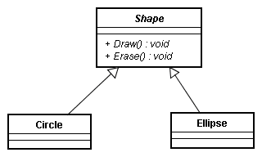
Derived Class and Base Class
When creating a class, instead of writing completely new data members and member functions, the programmer can designate that the new class that should inherit the members of an existing class
This existing class is called the base class
And the new class is referred to as the derived class

Slide 5
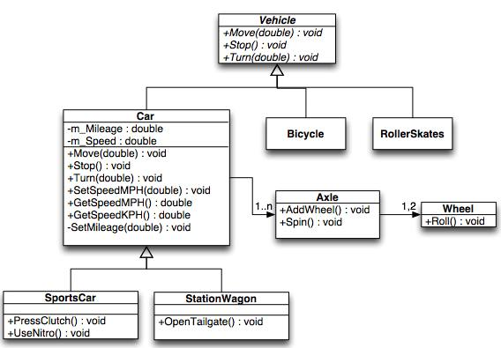
Derived Class and Base Class

Slide 6
Use of Inheritance
Consider that we have defined a class named Counter to count the number of people entering in a building
The class contains a routine to increment the variable count
And now we want to add the functionality of decrement as well (decrement the value of count)
There is a simple solution of adding another routine for decrement in the same class
But if we don’t want to play with the source code of Counter class
OR we don’t have the access to the source code of counter class
Then instead of writing the entire class again, we can directly use the Counter class by using the concept of inheritance
Have a look at the attached file “inheritance”

Slide 7
How to Derive a Class
We use the following syntax to derive a class from an existing class
class derived_class_name : access specifier base_class_name
class CountDn : public Counter
  class is the keyword
  class_name is any valid identifier
  A colon ( : ) is the part of syntax
  access specifier may be public, private or protected
The above statement means that CountDn is derived from the base class Counter

Slide 8
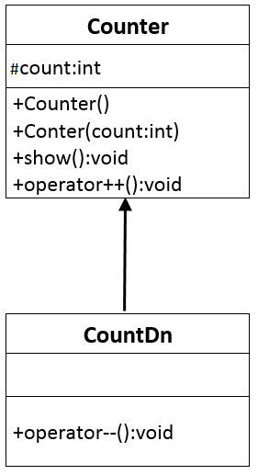
Generalization in UML Class Diagrams
In the UML, inheritance is called generalization, because the base class is a more general form of the derived class

Slide 9
Accessing Base Class Members
An important topic in inheritance is knowing when a member function in the base class can be used by objects of the derived class
This is called accessibility
Substituting Base Class Constructors
  On the creation of object of class CountDn c1, the constructor of base class is used
Substituting Base Class Member Functions
  The derived class has no member function, so to display the values of c1, the member functions of base class are used

Slide 10
Derived Class Constructor
What if we want to initialize the object of CountDn class from any other value?
Will the compiler use the overloaded constructor of base class?
The answer is NO
We need to define a new set of constructors in derived class
And instead of defining the constructor in a typical way, we will use the constructor of base class

Slide 11
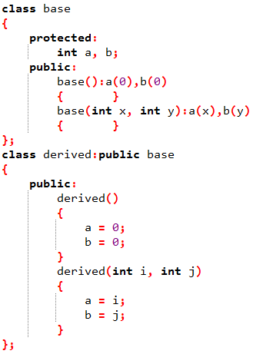
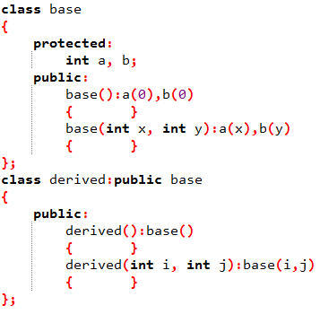
Defining Constructors in Derived Class
(when there are no Data Members in Derived Class)
The constructors in derived class are defined in two ways
  By using the constructors of base class
  By initializing the attributes inside the body of constructor

Slide 12
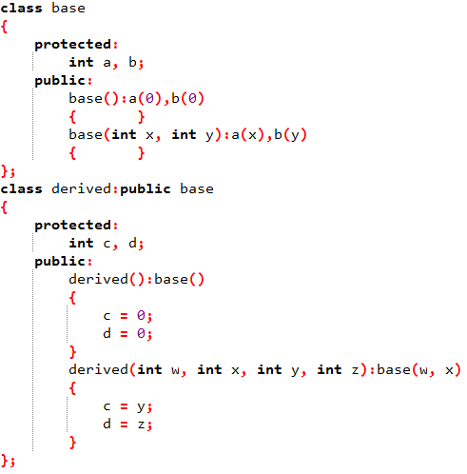
Defining Constructors in Derived Class
(when there are some Data Members in Derived Class)
When derived class has its own data, then the constructor for derived class can be written in two ways
  Initialize all the attributes of base and derived classes in the body of derived class constructor (as we did on previous slide)
  Use the base class constructor to initialize the base class attributes and initialize the derived class attributes inside the body of derived class constructor

Slide 13
Modes of Inheritance
When deriving a class from a base class, the base class may be inherited in three different modes
  Public mode
  Private mode
  Protected mode
We hardly use protected or private mode in inheritance, but public mode is commonly used
While using different modes of inheritance, rules mentioned in next three slides are applied

Slide 14
Public Mode
When deriving a class from a public base class
Public members of the base class become public members of the derived class
Protected members of the base class become protected members of the derived class
A base class's private members are never accessible directly from a derived class, but can be accessed through calls to the public and protected members of the base class
See the attached code with name “public_mode”

Slide 15
Private Mode
When deriving from a private base class
Public and protected members of the base class become private members of the derived class
See the attached code with name “private_mode”
Private inheritance is used when you want to inherit the implementation but don’t want to inherit the interface
  The interface is the part of the class's declaration that its users access directly
  The implementation is the part of the class's declaration that its users access only indirectly through the interface

Slide 16
Protected Mode
When deriving from a protected base class
Public and protected members of the base class become protected members of the derived class
Protected inheritance is a stage between public and private
Protected member functions cannot be accessed from outside the class but can be accessed from derived class
See the attached code with name “protected_mode”
If you want to inherit the implementation and don’t want to inherit the interface but at the same time you want to use the interface from another derived class you will use protected mode of inheritance

Slide 17
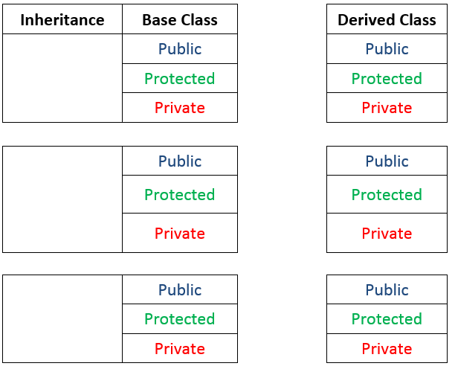

Modes of Inheritance (Summary)

Slide 18
Practice Problem 1
Suppose that you have a class named Shape with length and width as its data, this class has two functions to take the input and display the values of length and width.
Now define two other classes with the name Rectangle and Triangle to compute the area and perimeter of respective shapes
See the file named “Lecture_24_PP1” for solution

Slide 19
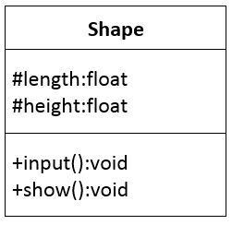
Creating a class by using UML class diagram
The question on previous slide can be asked in this way as well
We have a class as shown by the UML diagram, derive two more classes to compute the area and perimeter of triangle and rectangle

Slide 20
Function Overriding
C++ allows us to use the same identifier for the functions in different inter-related classes and this is called function overriding
  The function in base class is called overridden
  The function in derived class is called overriding
If you call that function on the object of derived class then the definition available in derived class is used
If you want to use the overridden function on derived class object then you will have to use scope resolution operator

Slide 21
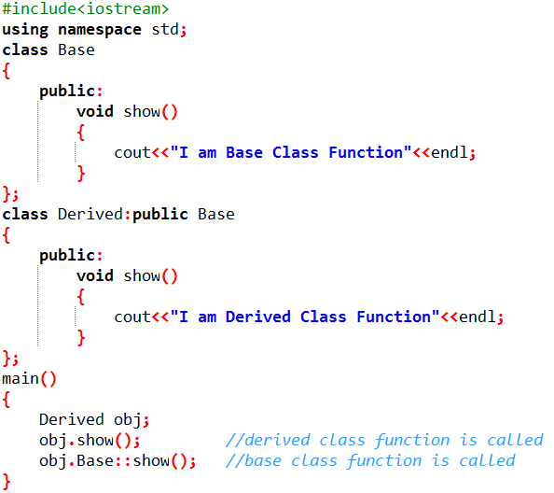
Function Overriding (Example)

Slide 22
Function Overriding and Overloading
Overriding
Overloading
Overriding of functions occurs when one class is inherited from another class
Overriding functions must have same parameters (type and number)
Overridden functions are in different scopes
Overriding is needed when derived class function has to do some added or different job than the base class function
Overloading can occur without inheritance
Overloaded functions must have different parameters (either type or number)
Overloaded functions are in same scope
Overloading is used to have same name functions which behave differently depending upon parameters passed to them

